Slide 1



/World.map
/System.panel
RAM
CPU
Firewall
RAM
CPU
Internet Modem
status bar
/command.console
/Taget.messages

Slide 2
/World.map
/System.panel
RAM
CPU
Firewall
RAM
CPU
Internet Modem
status bar
/command.console
/Taget.messages

Slide 3


/Target.messages
/World.map
/Target.needlist
/Command.console
/System.panel
/Status.monitor
RAM
Firewall
CPU
RAM
Internet Modem
CPU
Process Status(%)
HDD

Slide 4
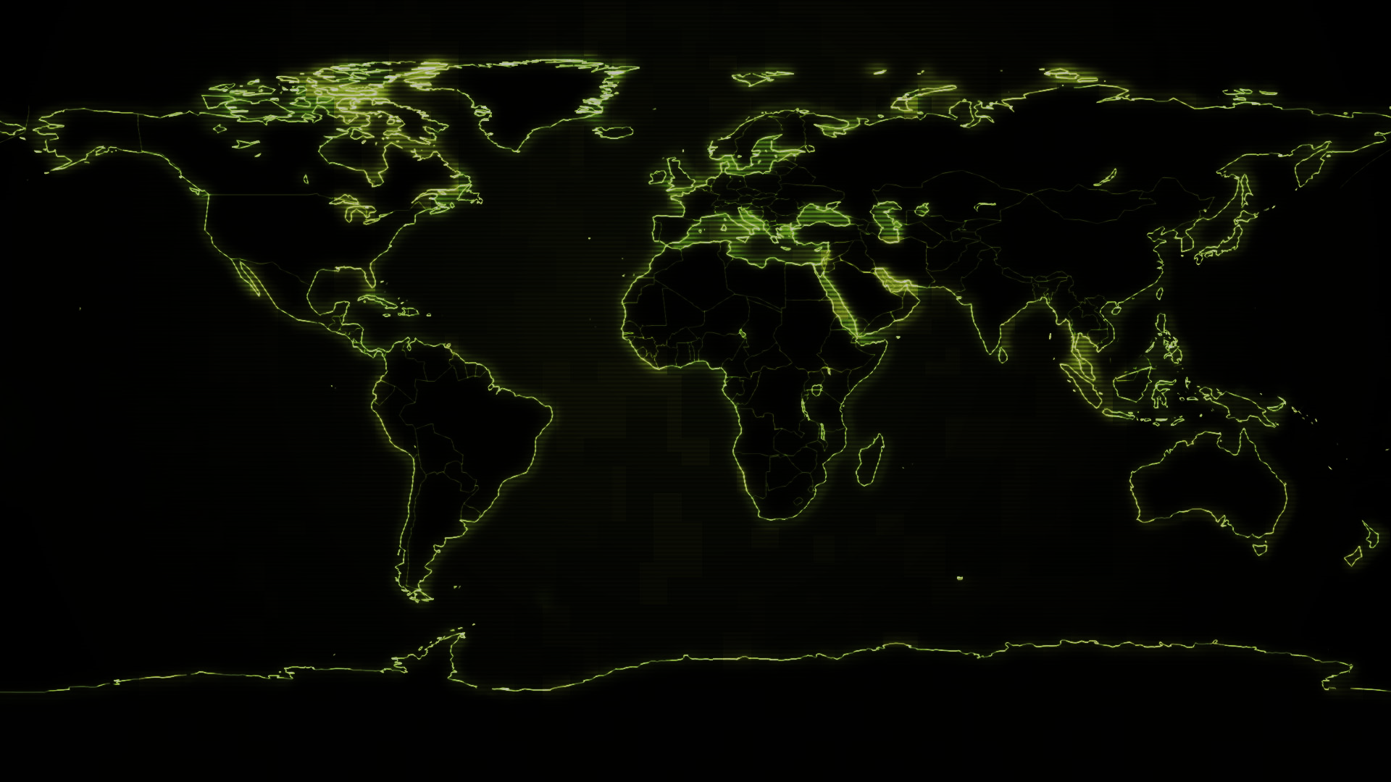
/Target.messages
/World.map
/Target.needlist
/Command.console
/System.panel
/Status.monitor
RAM
Firewall
CPU
RAM
Internet Modem
CPU
Process Status(%)
HDD

Slide 5

/Target.messages
/World.map
/Target.needlist
/Command.console
/System.panel
/Status.monitor
CPU
RAM
Firewall
CPU
RAM
Internet Modem
Process Status(%)
HDD

Slide 6

/Target.messages
/World.map
/Target.needlist
/Command.console
/System.panel
/Status.monitor
CPU
RAM
Firewall
CPU
RAM
Internet Modem
Process Status(%)
HDD

Slide 7
921, 521
1004, 537
725, 557
725, 608
921, 604
1004, 590
1004, 673
Firewall
Internet Modem
CPU
RAM
HDD
Firewall Lv.1
1mbps internet
1 GHz
CPU
1 GB
1 TB
Firewall Lv.2
2mbps internet
2 GB
2 TB
2 GHz
CPU
Firewall Lv.3
4mbps internet
4 GB
4 TB
Firewall Lv.4
8mbps internet
8 GB
8 TB
4 GHz
CPU
Qtum
CPU

Slide 8
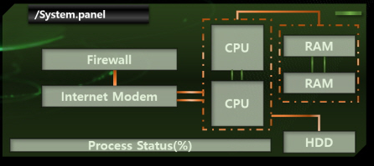
Firewall
Internet Modem
CPU
RAM
HDD
Firewall Lv.1
1mbps internet
1 GHz
CPU
1 GB
1 TB
Firewall Lv.2
2mbps internet
2 GB
2 TB
2 GHz
CPU
Firewall Lv.3
4mbps internet
4 GB
4 TB
Firewall Lv.4
8mbps internet
8 GB
8 TB
4 GHz
CPU
Qtum
CPU

Slide 9
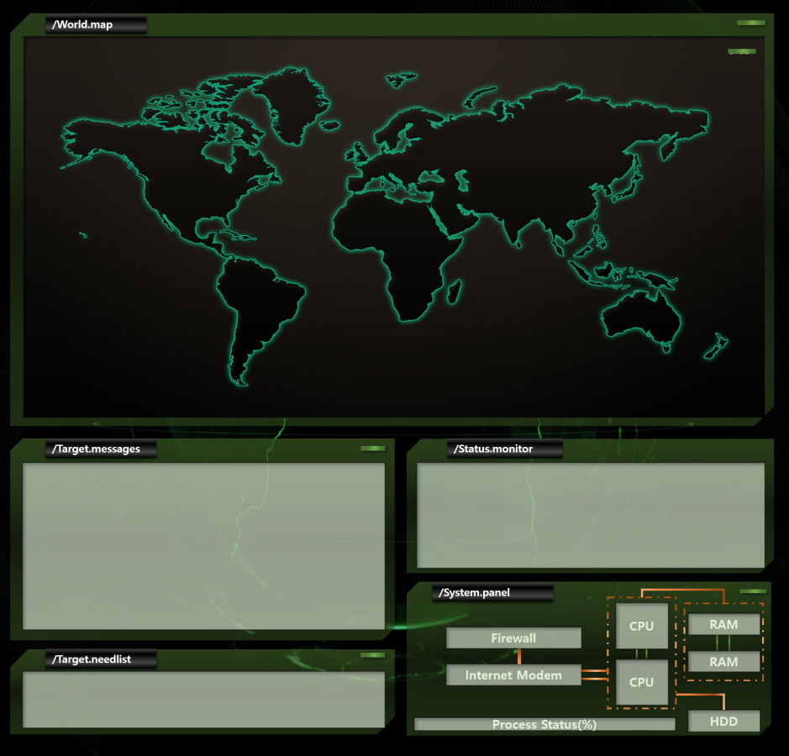

Slide 10
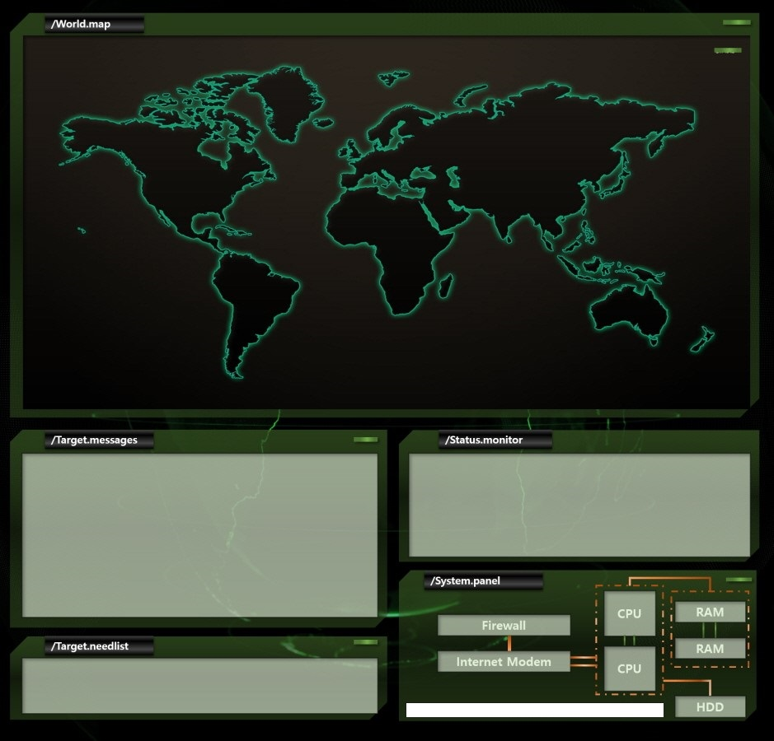


Slide 11
Game Over

